Slide 1

Intermediate Code Generation

Slide 2
Outline
Variants of Syntax Trees
Three-address code
Types and declarations
Translation of expressions
Type checking
Control flow
Backpatching

Slide 3
Introduction
Intermediate code is the interface between front end and back end in a compiler
Ideally the details of source language are confined to the front end and the details of target machines to the back end (a m*n model)
In this chapter we study intermediate representations, static type checking and intermediate code generation
Parser
Static
Checker
Intermediate Code Generator
Code Generator
Front end
Back end

Slide 4
Variants of syntax trees
It is sometimes beneficial to crate a DAG instead of tree for Expressions.
This way we can easily show the common sub-expressions and then use that knowledge during code generation
Example: a+a*(b-c)+(b-c)*d
+
+
*
*
d
a
-
b
c

Slide 5
SDD for creating DAG’s
Production
Semantic Rules
E -> E1+T
E -> E1-T
E -> T
T -> (E)
T -> id
T -> num
E.node= new Node(‘+’, E1.node,T.node)
E.node= new Node(‘-’, E1.node,T.node)
E.node = T.node
T.node = E.node
T.node = new Leaf(id, id.entry)
T.node = new Leaf(num, num.val)
Example:
p1=Leaf(id, entry-a)
P2=Leaf(id, entry-a)=p1
p3=Leaf(id, entry-b)
p4=Leaf(id, entry-c)
p5=Node(‘-’,p3,p4)
p6=Node(‘*’,p1,p5)
p7=Node(‘+’,p1,p6)
p8=Leaf(id,entry-b)=p3
p9=Leaf(id,entry-c)=p4
p10=Node(‘-’,p3,p4)=p5
p11=Leaf(id,entry-d)
p12=Node(‘*’,p5,p11)
p13=Node(‘+’,p7,p12)

Slide 6
Value-number method for constructing DAG’s
=
id
To entry for i
num
10
+
+
1
2
3
1
3
i
10
Algorithm
  Search the array for a node M with label op, left child l and right child r
  If there is such a node, return the value number M
  If not create in the array a new node N with label op, left child l, and right child r and return its value
We may use a hash table

Slide 7
Three address code
In a three address code there is at most one operator at the right side of an instruction
Example:
+
t1 = b – c
t2 = a * t1
t3 = a + t2
t4 = t1 * d
t5 = t3 + t4
+
*
*
d
a
-
b
c

Slide 8
Forms of three address instructions
x = y op z
x = op y
x = y
goto L
if x goto L and ifFalse x goto L
if x relop y goto L
Procedure calls using:
  param x
  call p,n
  y = call p,n
x = y[i] and x[i] = y
x = &y and x = *y and *x =y

Slide 9
Example
do i = i+1; while (a[i] < v);
L: t1 = i + 1
i = t1
t2 = i * 8
t3 = a[t2]
if t3 < v goto L
100: t1 = i + 1
101: i = t1
102: t2 = i * 8
103: t3 = a[t2]
104: if t3 < v goto 100
Symbolic labels
Position numbers

Slide 10
Data structures for three address codes
Quadruples
  Has four fields: op, arg1, arg2 and result
Triples
  Temporaries are not used and instead references to instructions are made
Indirect triples
  In addition to triples we use a list of pointers to triples

Slide 11
Example
Three address code
t1 = minus c
t2 = b * t1
t3 = minus c
t4 = b * t3
t5 = t2 + t4
a = t5
b * minus c + b * minus c
Quadruples
Triples
Indirect Triples
op
arg1
arg2
result
op
arg1
arg2
op
op
arg1
arg2
minus
c
t1
0
minus
c
35
(0)
0
minus
c
*
b
t1
t2
1
*
b
(0)
36
(1)
1
*
b
(0)
minus
c
t3
2
minus
c
37
(2)
2
minus
c
*
b
t3
t4
3
*
b
(2)
38
(3)
3
*
b
(2)
+
t2
t4
t5
4
+
(1)
(3)
39
(4)
4
+
(1)
(3)
=
t5
a
5
=
a
(4)
40
(5)
5
=
a
(4)

Slide 12
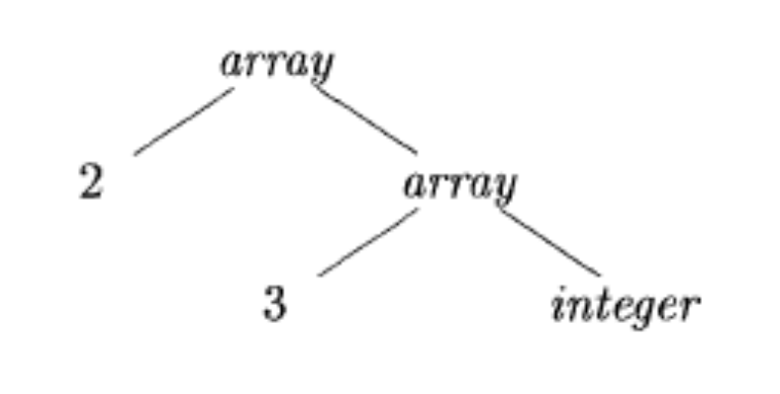
Type Expressions
Example: int[2][3]
array(2,array(3,integer))
A basic type is a type expression
A type name is a type expression
A type expression can be formed by applying the array type constructor to a number and a type expression.
A record is a data structure with named field
A type expression can be formed by using the type constructor  for function types
If s and t are type expressions, then their Cartesian product s*t is a type expression
Type expressions may contain variables whose values are type expressions

Slide 13
Type Equivalence
They are the same basic type.
They are formed by applying the same constructor to structurally equivalent types.
One is a type name that denotes the other.

Slide 14

Declarations

Slide 15
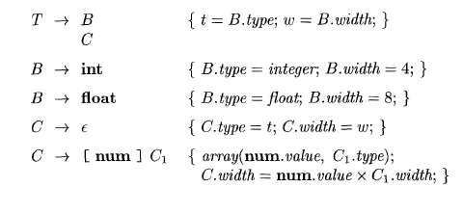
Storage Layout for Local Names
Computing types and their widths

Slide 16
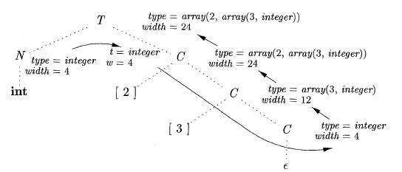
Storage Layout for Local Names
Syntax-directed translation of array types

Slide 17
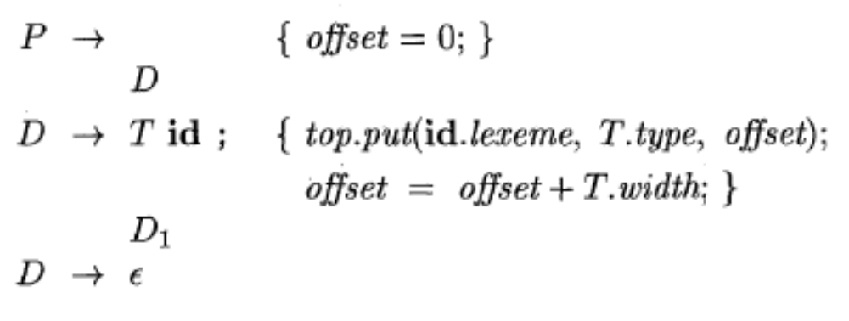

Sequences of Declarations
Actions at the end:

Slide 18
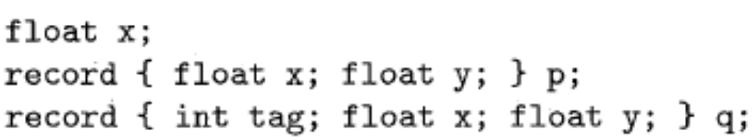
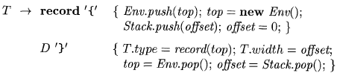
Fields in Records and Classes

Slide 19
Translation of Expressions and Statements
We discussed how to find the types and offset of variables
We have therefore necessary preparations to discuss about translation to intermediate code
We also discuss the type checking

Slide 20
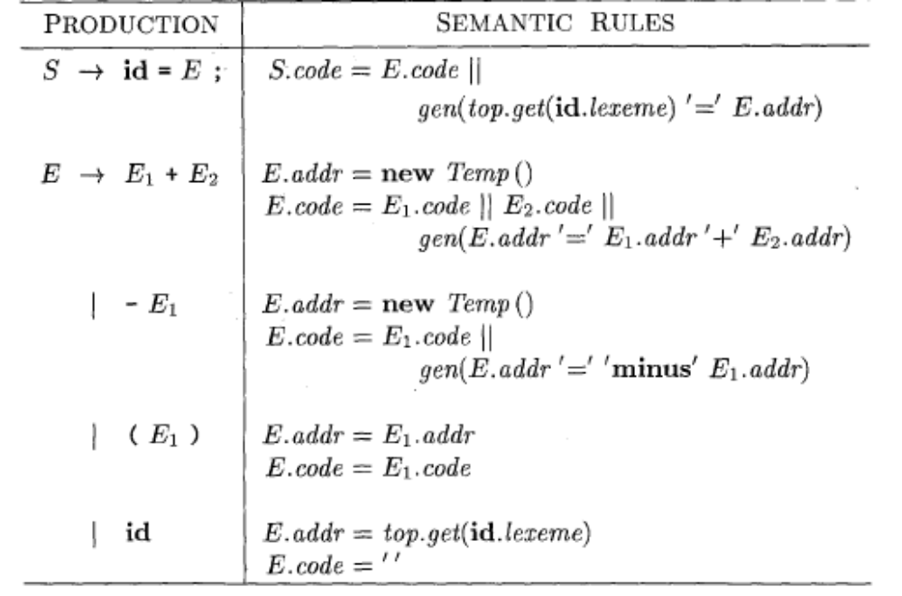
Three-address code for expressions

Slide 21
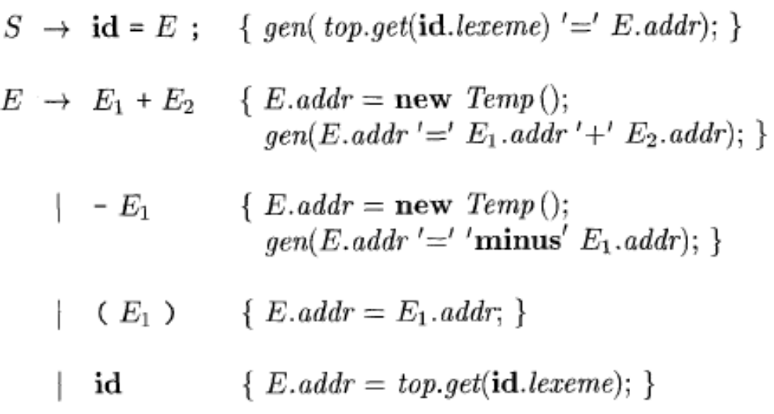
Incremental Translation

Slide 22
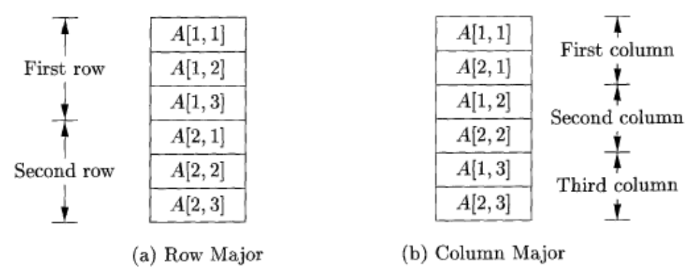
Addressing Array Elements
Layouts for a two-dimensional array:

Slide 23
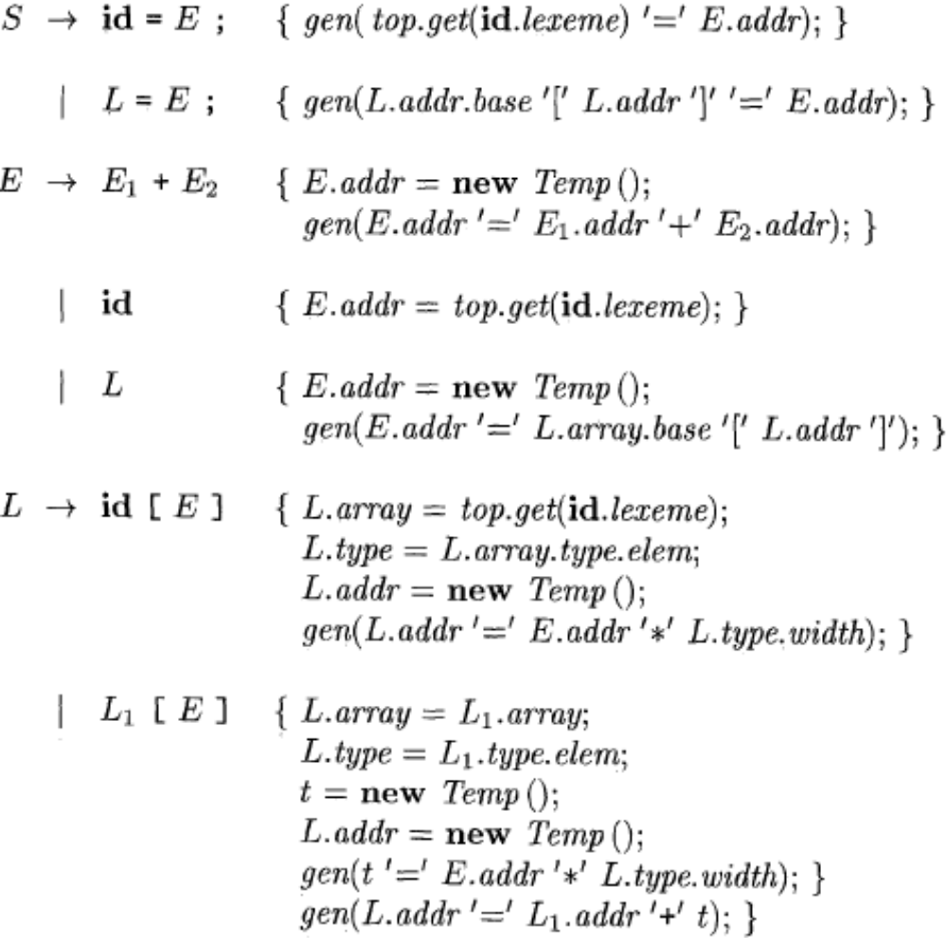
Semantic actions for array reference

Slide 24
Translation of Array References
Nonterminal L has three synthesized attributes:
L.addr
L.array
L.type

Slide 25
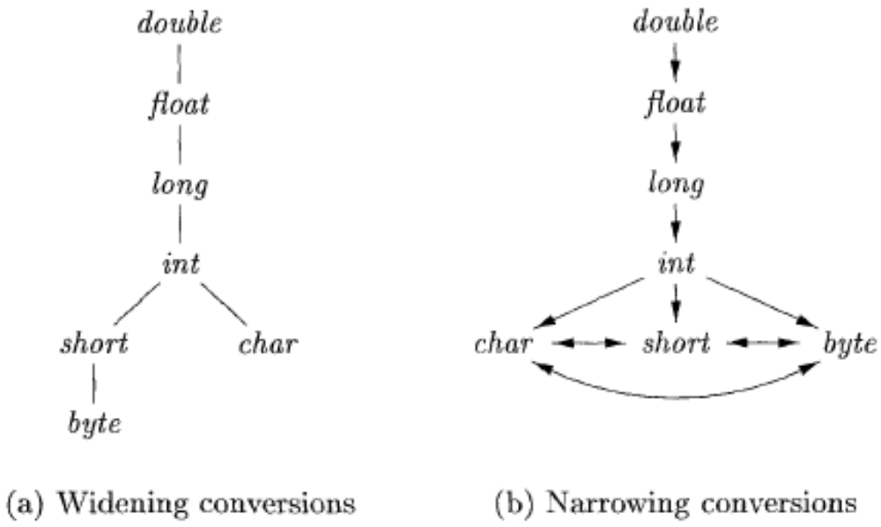
Conversions between primitive types in Java

Slide 26
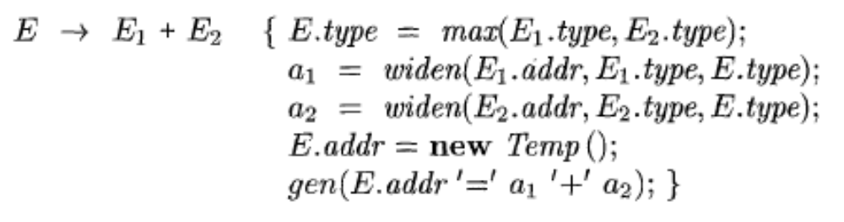
Introducing type conversions into expression evaluation

Slide 27
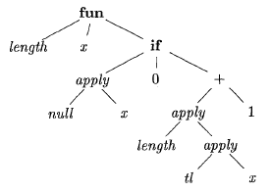
Abstract syntax tree for the function definition
fun length(x) =
if null(x) then 0 else length(tl(x)+1)
This is a polymorphic function
in ML language

Slide 28
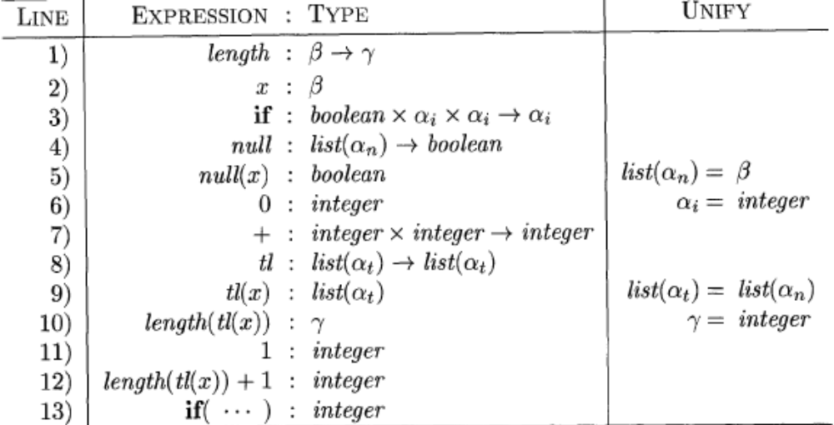
Inferring a type for the function length

Slide 29
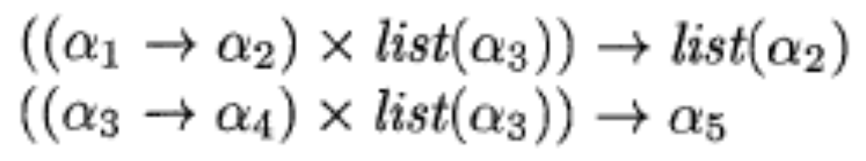
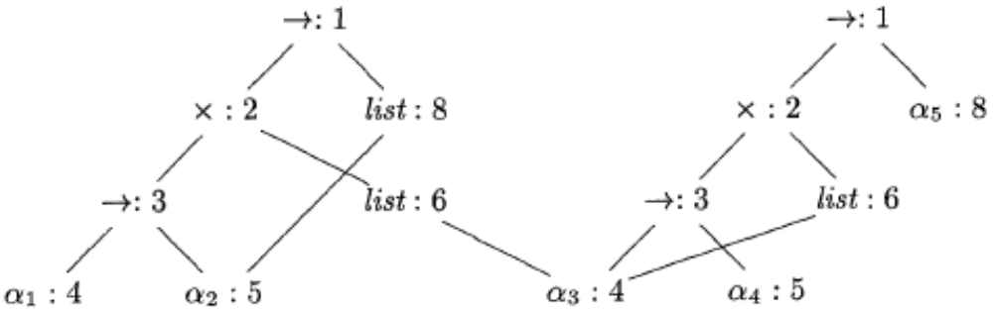
Algorithm for Unification

Slide 30
Unification algorithm
boolean unify (Node m, Node n) {
s = find(m); t = find(n);
if ( s = t ) return true;
else if ( nodes s and t represent the same basic type ) return true;
else if (s is an op-node with children s1 and s2 and
t is an op-node with children t1 and t2) {
union(s , t) ;
return unify(s1, t1) and unify(s2, t2);
}
else if s or t represents a variable {
union(s, t) ;
return true;
}
else return false;
}

Slide 31
Control Flow
boolean expressions are often used to:
Alter the flow of control.
Compute logical values.

Slide 32
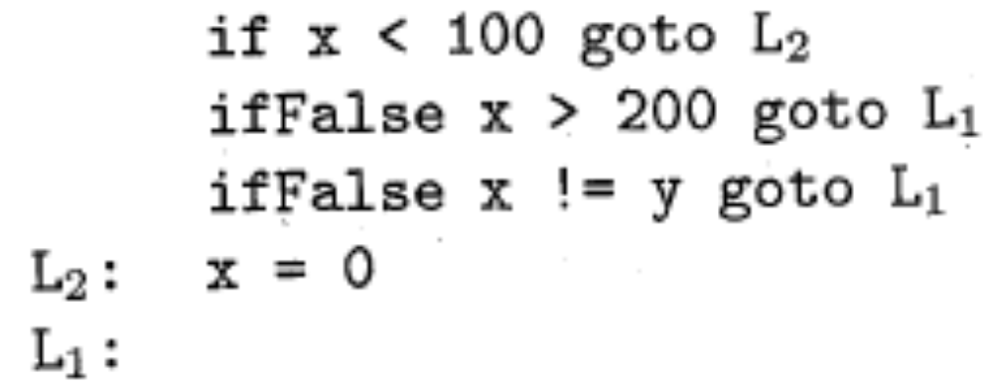
Short-Circuit Code

Slide 33
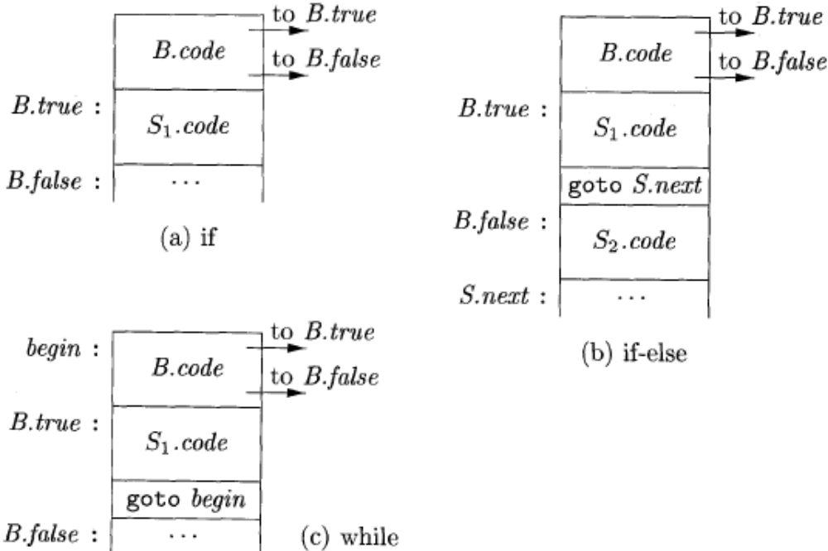
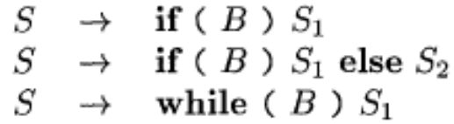
Flow-of-Control Statements

Slide 34
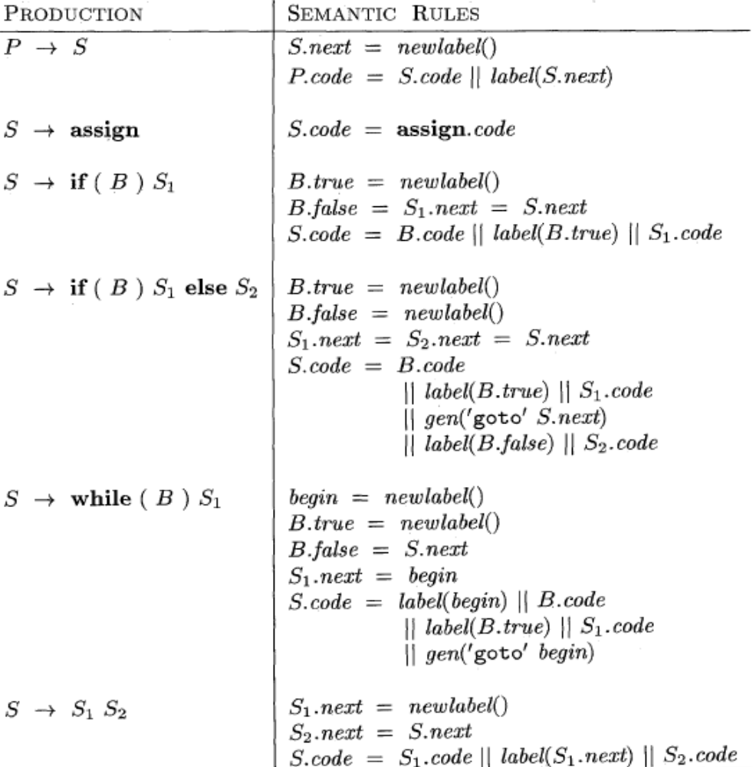
Syntax-directed definition

Slide 35
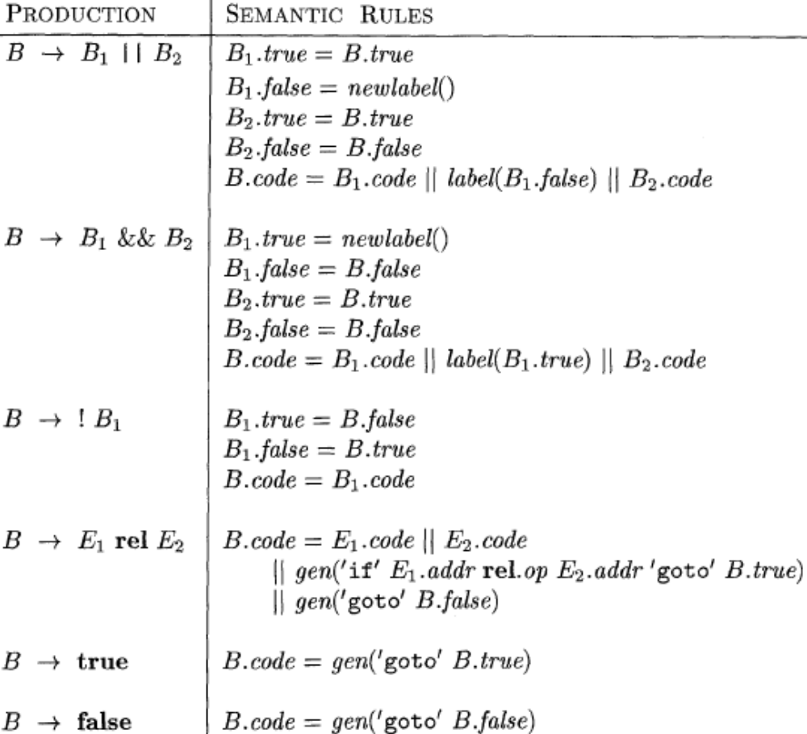
Generating three-address code for booleans

Slide 36
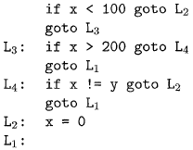
translation of a simple if-statement

Slide 37
Backpatching
Previous codes for Boolean expressions insert symbolic labels for jumps
It therefore needs a separate pass to set them to appropriate addresses
We can use a technique named backpatching to avoid this
We assume we save instructions into an array and labels will be indices in the array
For nonterminal B we use two attributes B.truelist and B.falselist together with following functions:
  makelist(i): create a new list containing only I, an index into the array of instructions
  Merge(p1,p2): concatenates the lists pointed by p1 and p2 and returns a pointer to the concatenated list
  Backpatch(p,i): inserts i as the target label for each of the instruction on the list pointed to by p

Slide 38
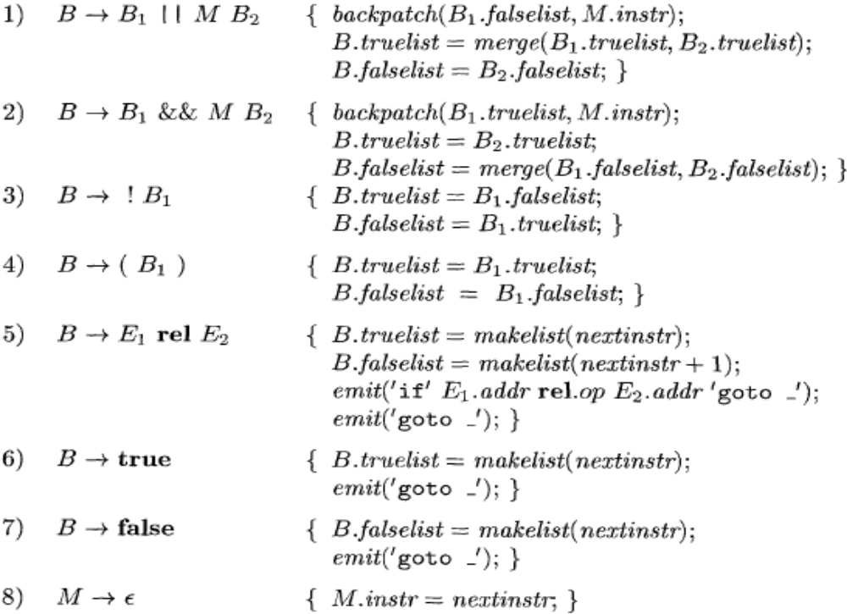
Backpatching for Boolean Expressions

Slide 39
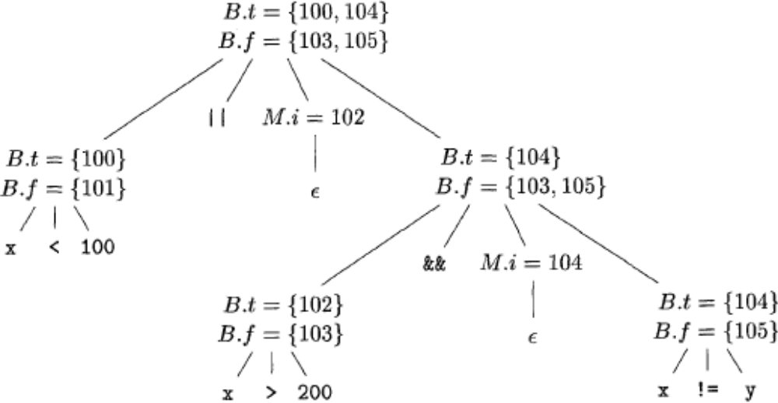
Backpatching for Boolean Expressions
Annotated parse tree for x < 100 || x > 200 && x ! = y

Slide 40
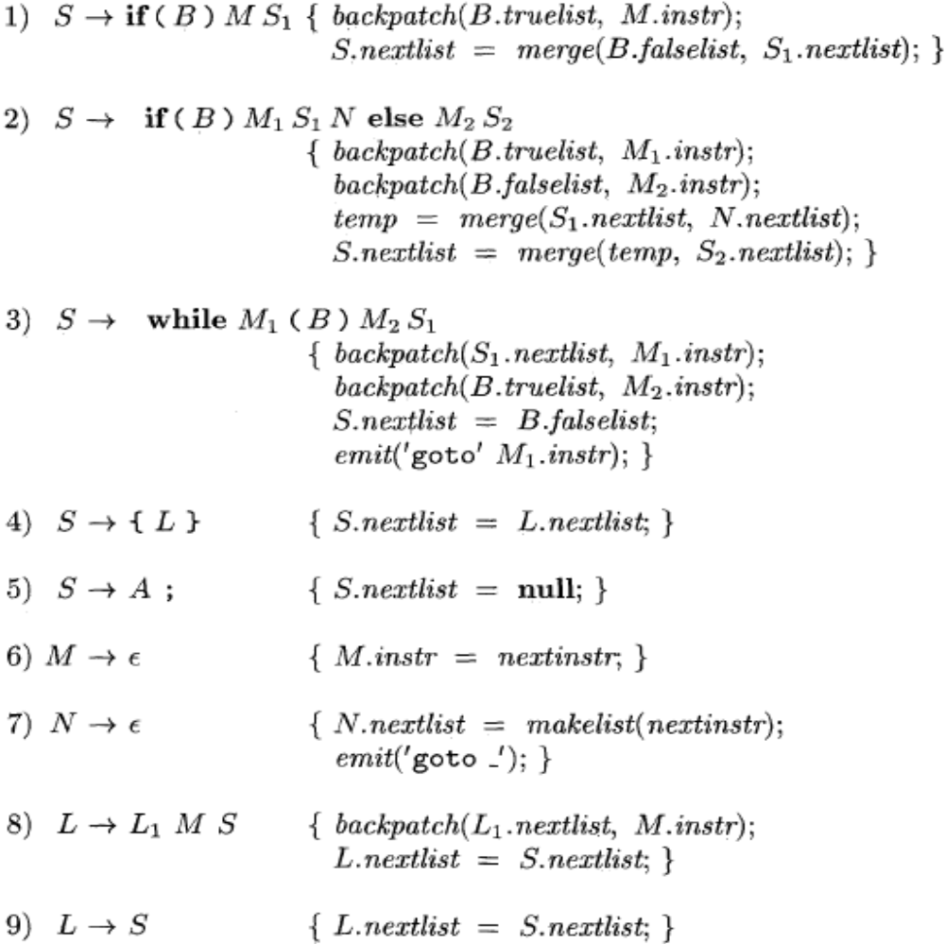
Flow-of-Control Statements

Slide 41
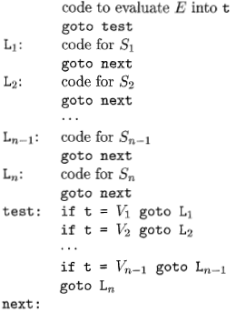
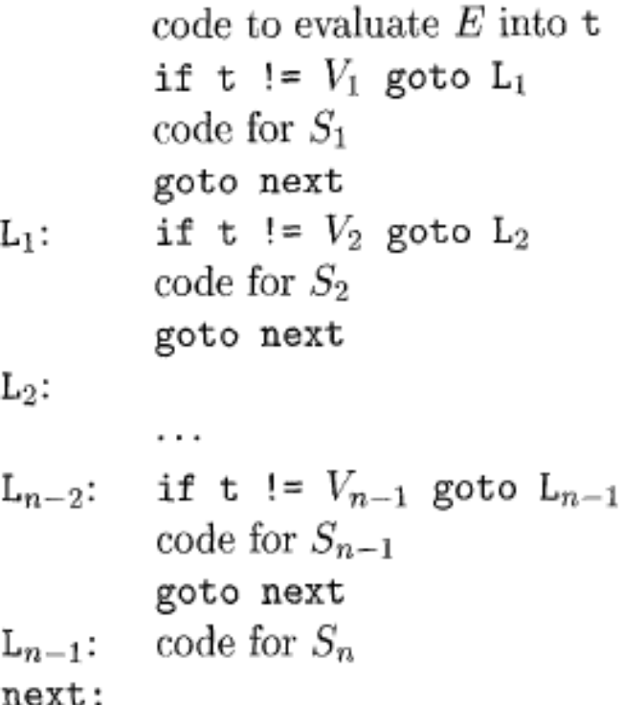
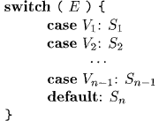
Translation of a switch-statement

